Slide 1




overall_1_132573879104528179 columns_1_132573879104528179
Microsoft Office Add-ins
Community call
AppSource Add-in Validation Improvements
Blazor in Office Add-ins
Add-in command changes
Community ideas
May 11, 2022

Slide 2
Agenda
AppSource: Add-in validation Improvements
Blazor in Office Add-ins
Add-in command changes
Community ideas
Abid Rahman
Linda Cannon
Maarten van Stam
Juan Balmori
Product Manager
Senior Content Project Manager
MVP Office Add-ins
Principal Program Manager

Slide 3
AppSource: Add-in validation improvements
Juan Balmori: Principal Product Manager

Slide 4
Agenda
Browser Support Update
In a nutshell: we will no longer reject add-ins not supporting Trident!
Top Validation Failures
Share our top 10 failures so you can help yourself publishing your Add-in faster!

Slide 5
Context
Many months ago, we announced IE will not longer be supported (for Office Web Apps)
An Exception to the Above was Web Add-ins running on Win32, we still can activate your add-in in IE (Trident) if you are in:
Office 2013 msi -> Extended support ending on April 11, 2023
Office 2016, 2019 msi -> Extended support ending on October 14th, 2025
Windows 7, 8, and 10 < 1903
Folks in M365 subscriptions (monthly or semi-annual) are with high probability running in WebView2.
Good news !
Telemetry indicates WebView2 has become mainstream with a very significant % of Office Add-ins activations.
Hence, we are now “recommending” to support Trident, but its not required to be in the store.
If your add-in fails to load in Trident we will Soft-fail it.
Effective immediately.

Slide 6
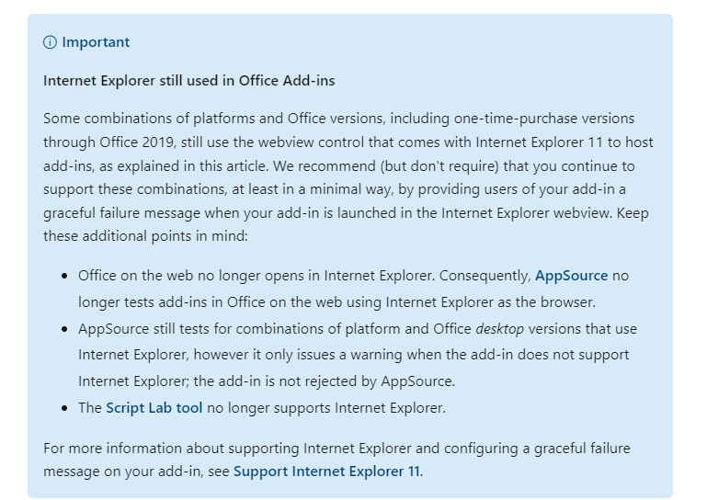
Documentation Updated!

Slide 7
Top Failures when validating Add-ins
Testing notes
First run experience.
External Service experience: Sign In-out, Sign up links
Additional charges disclosure
Provider Name Match
Functionality as described.
High Resolution Icon.
Environment compatibility

Slide 8
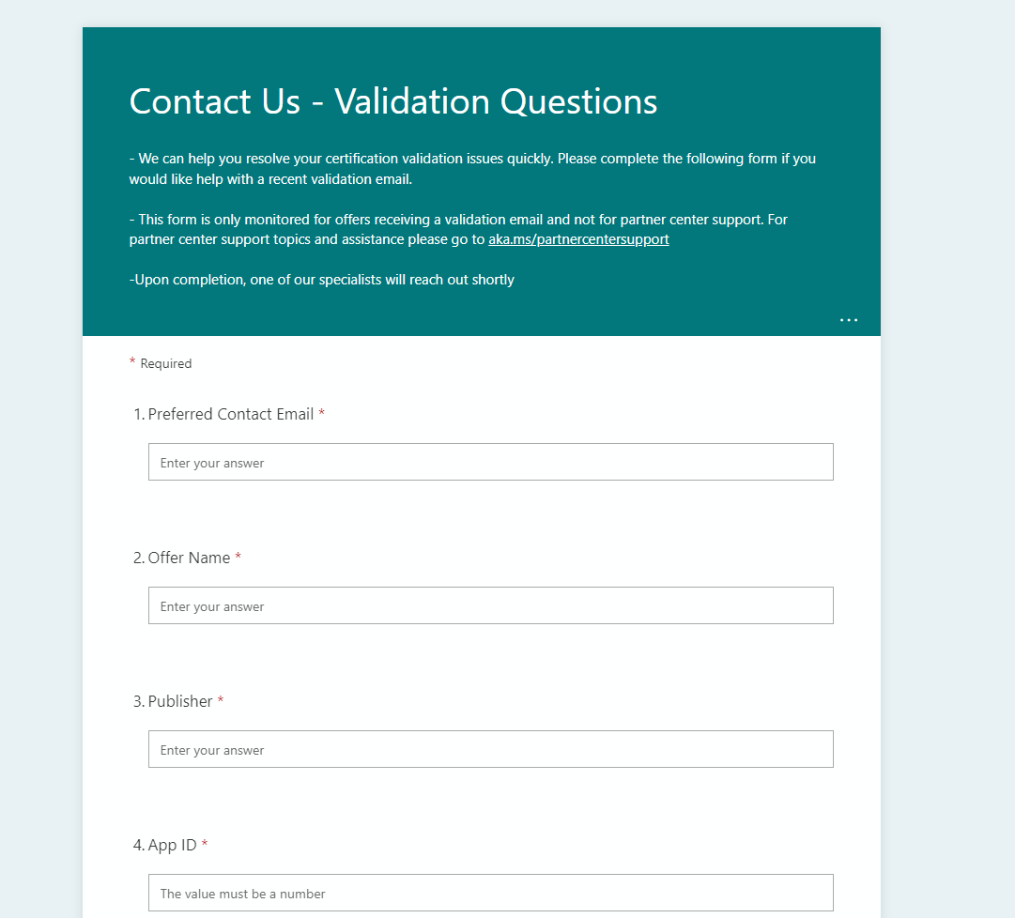
Directly Engage with Validation Team!
PAST: Add-in gets rejected -> Challenges to validation were made via CSS support tickets
Announcing: direct interaction with Validation Team.
Find the link on your certification report e-mail to contact our team directly. (via Forms)
This will reduce enormously our response times.

Slide 9
Blazor in Office Add-ins
Maarten van Stam: MVP Office Add-ins

Slide 10
Maarten’s slides here

Slide 11
Add-in command changes
Abid Rahman: Product Manager

Slide 12
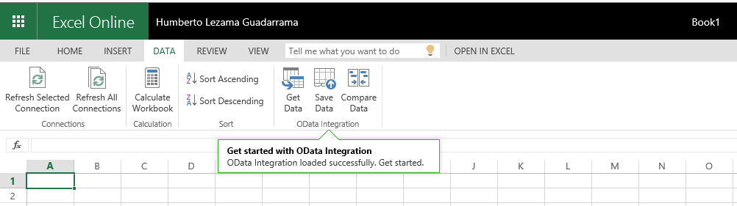
What are add-in commands?
Add-in commands extend native parts of Office applications and can perform one of two actions:
ShowTaskpane
ExecuteFunction

Slide 13
ExecuteFunction add-in commands are defined in the manifest as:
<Action xsi:type="ExecuteFunction"> <FunctionName>writeText</FunctionName>
</Action>

Slide 14
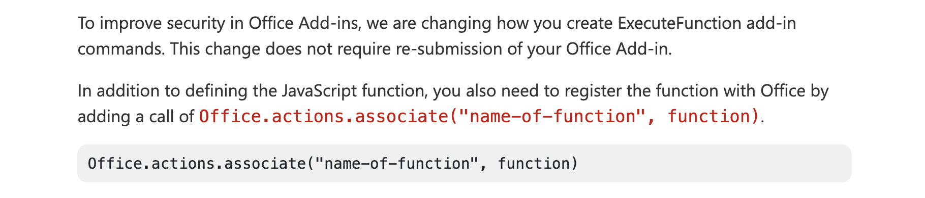

Slide 15
// Define the function.
function writeText(event) {
// Implement your custom code here. The following code is a simple example.
Office.context.document.setSelectedDataAsync("ExecuteFunction works. Button ID=" + event.source.id,
function (asyncResult) {
var error = asyncResult.error;
if (asyncResult.status === Office.AsyncResultStatus.Failed) {
// Show error message.
}
else {
// Show success message.
}
});
// Calling event.completed is required. event.completed lets the platform know that processing has completed.
event.completed();
}
// You must register the function with the following line.
Office.actions.associate("writeText", writeText);

Slide 16
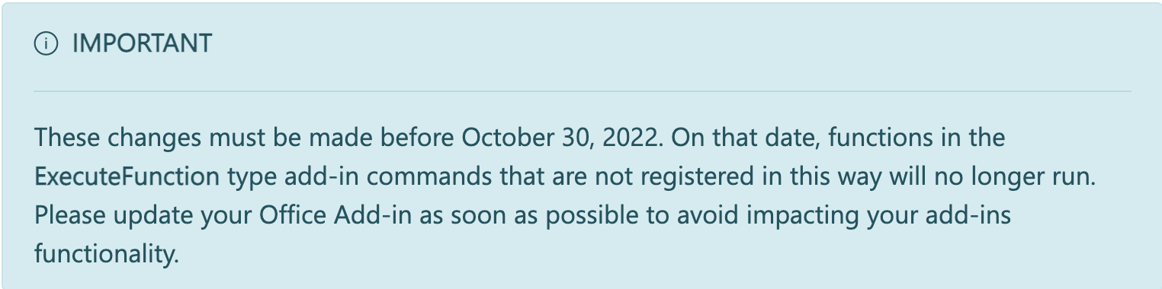
Announcing changes to Office Add-ins' ExecuteFunction commands - Microsoft 365 Developer Blog
You can find complete add-in samples in our GitHub repo. To learn more about add-in commands, see our documentation.
For questions, we invite you to join our monthly Office Add-ins community call. Lastly, if you run across any issues, please report them in the Github repo.

Slide 17
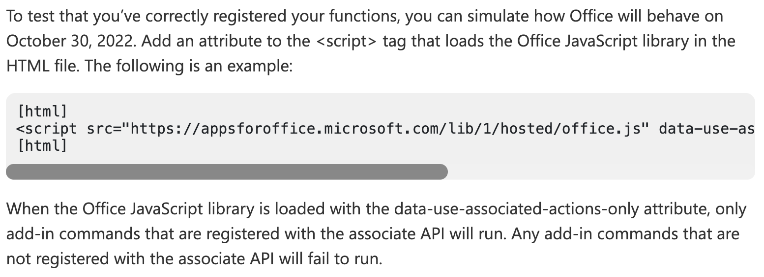
<script src="https://appsforoffice.microsoft.com/lib/1/hosted/office.js" data-use-associated-actions-only="1" type="text/javascript"></script>

Slide 18
Community ideas
Linda Cannon: Senior Content Product Manager

Slide 19
Help shape the future of Microsoft 365 developer suggestions/ideas
Recap: current situation
Options
Stay put at https://aka.ms/m365dev-suggestions
Open new issue at https://github.com/OfficeDev/office-js
Move to new all-up Microsoft Ideas forum at Feedback · Community (microsoft.com)

Slide 20
Samples discussion
We’re looking for your feedback and suggestions for what you need from samples for Office Add-ins.
Please join us June 15th at 8:00 AM Pacific Time.
https://aka.ms/officeaddinsamples-call
Notes:
m365-dev-sig

Slide 21
1. I'd love to follow-up on this feature request: Office JS Save and Close methods for Word, Excel and PowerPoint Apologies for my persistence... but this is literarily the only blocking issue for us to move from the old add-ins to the JS add-ins platform. We would really really appreciate if you could push this into the roadmap (and we represent many clients with many employees, so do not take the 20 upvotes at face value, we represent hundreds of users and the deployments of the old add-ins and updates are not ideal...). Thank you so much.
Answer:
Thanks for your persistence! We're sorry you are being blocked by this. Unfortunately we can't add this to the roadmap at this time, but we will continue to keep an eye on the request.
As a workaround you may want to explore continuing to use your COM add-in for full functionality while adding partial functionality in the web add-in for cross-platform support. We recommend exploring this article for more information. Make your Office Add-in compatible with an existing COM add-in
Q&A

Slide 22
2. Open Outlook mobile API to compose scenarios to insert attachments in emails. Currently, third party cloud storage companies cannot integrate directly into Outlook mobile. With this API, we would be able to click a button and insert files from private cloud storage providers into emails. Thank you
Answer:
We'd like to know more about this scenario. Can you please create a feature request with more information at https://aka.ms/m365dev-suggestions? Thanks!
Q&A

Slide 23
3. How to communicate from a Word add-in to Office JS task pane? For example, OnContentEnter, highlight one HTML control in the task pane.
Answer:
We see this question was also posted to the Q&A site. It seems like you should be able to use the onSelectionChanged event. If not can you please follow up with more information on the Q&A site? Thanks!
4. Are you planning on upgrading the Visual Studio Web Add-in Templates to ASP.NET Core?
Answer:
We are looking into some updates to the Visual Studio Office Add-in templates, but don't have anything on the roadmap at this time. Can you let us know more about what you'd like to see in these templates by posting a request at https://aka.ms/m365dev-suggestions? Thanks!
Q&A

Slide 24
5. Has the PowerPoint API 1.3 been officially released to all platforms?
Answer:
The PowerPoint JavaScript API 1.3 requirement set is supported on Windows, Mac, and the web (but not iOS or mobile at this time.) See PowerPoint JavaScript API requirement sets for complete details.
Q&A

Slide 25
I have two questions both relating to getAccessToken
(1) Can you clarify which namespace we should be using to access the getAccessToken method please? The Microsoft answer to this post says that we should be using the OfficeRuntime.Auth.getAccessToken. But the third sentence on this page says that the "Office.auth.getAccessToken" will be the one to receive updates in the future.
(2) Why does the documentation refer to "Office.auth" when the full namespace is "Office.context.auth"? Could you confirm that the full namespace is actually Office.context.auth.getAccessToken and not Office.auth.getAccessToken
Answer:
You can use either OfficeRuntime.auth.getAccessToken(), or Office.auth.getAccessToken(). Both are equivalent. To be consistent we’re in the process of updating docs/samples to always use Office.auth.getAccessToken(). https://docs.microsoft.com/en-us/javascript/api/office-runtime/officeruntime.auth?view=common-js-preview
Q&A

Slide 26
During the last call, one of my questions was if it would be possible to programmatically let the compose window disappear after the user clicked on a custom "Encrypt and Send" button, as the mail already is encrypted, and send as MIME payload via the send message Graph API.
You suggested to use smart alerts to handle the send event, however, this is not ideal for our use-case, as the on send event is triggered on each email, but we want that the user deliberately decides via the custom button if she/he wants to encrypt the email or not…
Answer:
We’ll work to follow up in the blog post with more info.
Q&A

Slide 27
Is there a way for the admin to install an Excel add-in for the user or group that will show only for some Excel files generated by our application and not when the user creates a new Excel file or some other Excel files opened by the user?
Answer:
We’ll follow up in the blog post with more info.
Q&A

Slide 28



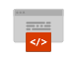


New to Office Add-ins?
 | Documentation | https://aka.ms/office-add-ins-docs
 | Quick starts | Outlook, Excel, Word, PowerPoint
 | Script Lab | https://aka.ms/getscriptlab
 | Samples | https://aka.ms/officeaddinsamples
 | Microsoft 365 Developer Program | https://aka.ms/M365devprogram
 | Office Scripts | aka.ms/office-scripts-docs
Notes:
m365-dev-sig

Slide 29
Engage with the team
Engagement | Where to go
Technical questions about Office Add-ins | https://aka.ms/office-addins-dev-questions [office-js-dev] [office-addins-dev] https://stackoverflow.com [office-js] [outlook-web-addins] [office-scripts]
Product bugs | https://github.com/OfficeDev/office-js
Feature requests and ideas | https://aka.ms/m365dev-suggestions
Send a Smile or Frown | Inside Office
Notes:
m365-dev-sig

Slide 30
Microsoft 365 developer community calls
Microsoft 365 platform call (weekly) https://aka.ms/m365-dev-call
Adaptive Cards (monthly) https://aka.ms/adaptivecardscommunitycall
Microsoft identity platform (monthly) https://aka.ms/IDDevCommunityCalendar
Office Add-ins (monthly) https://aka.ms/officeaddinscommunitycall
PowerApps (monthly) https://aka.ms/PowerAppsMonthlyCall
Microsoft 365 Community (bi-weekly) https://aka.ms/m365-dev-sig
SharePoint Framework (bi-weekly) https://aka.ms/spdev-spfx-call
All calls and assets: https://aka.ms/m365pnp
Notes:
m365-dev-sig

Slide 31
Thank you
Recording will be available in 24 hours on
Microsoft 365 Community (PnP) YouTube channel
https://aka.ms/M365PnP/videos
(subscribe today)
Follow us on Twitter
@Microsoft365Dev | @M365PnP
Next call: June 8th at 8:00 AM Pacific Time
https://aka.ms/officeaddinscommunitycall
Agenda: https://aka.ms/officeaddinsagenda
Submit your questions: https://aka.ms/officeaddinsform

